Slide 1
CHATGPT: IMPACT OF CONTROLLABLE TEXT GENERATION ON SOFTWARE ENGINEERING EDUCATION
Cansu Çiğdem Ekin Güzin Türkmen Murat Karakaya
Bilgisayar Mühendisliği
Atılım Üniversitesi

Slide 2
Content
Background
Potentials for Learners and Educators
Risks for Learners and Educators
Discussion and Conclusions

Slide 3
Background
Natural Language Processing (NLP)
Transformer Deep Learning models
Controllable Text Generation (CTG) is a task in NLP that involves generating text that adheres to certain constraints or meets specific objectives.
These constraints or objectives can include things like style, tone, length, or content.

Slide 4
Background
Various Transformer models for CTG
GPT-3 (Generative Pre-trained Transformer 3)
CTRL (Controllable Transformer)
T5 (Text-To-Text Transfer Transformer)
TextGAN (Generative Adversarial Networks for Text)
and many more…

Slide 5
Background
GPT-3 (Generative Pre-trained Transformer 3) is a large-scale transformer model developed by OpenAI [1].
It is trained on a massive dataset of web pages and has been shown to perform well on a wide range of NLP tasks, including CTG.
ChatGPT is based on GPT-3 but it is trained using Reinforcement Learning from Human Feedback (RLHF) with a slight different data collection setup.

Slide 6
Background
In this paper, we will use the recently published ChatGPT transformer model to demonstrate the potentials and risks for teachers and learners in the Software Engineering (SE) education context.

Slide 7
Potentials for Learners and Educators

Slide 8
Potentials for Learners and Educators Personalized Learning Materials
By using CTG, educators can generate instructional materials that are tailored to the specific needs and learning styles of their students
This can be particularly useful for students who may have learning disabilities or other challenges that require more customized instructional approaches.
Students may be more likely to understand and retain information when it is presented in a way that is tailored to their needs and learning style.

Slide 9
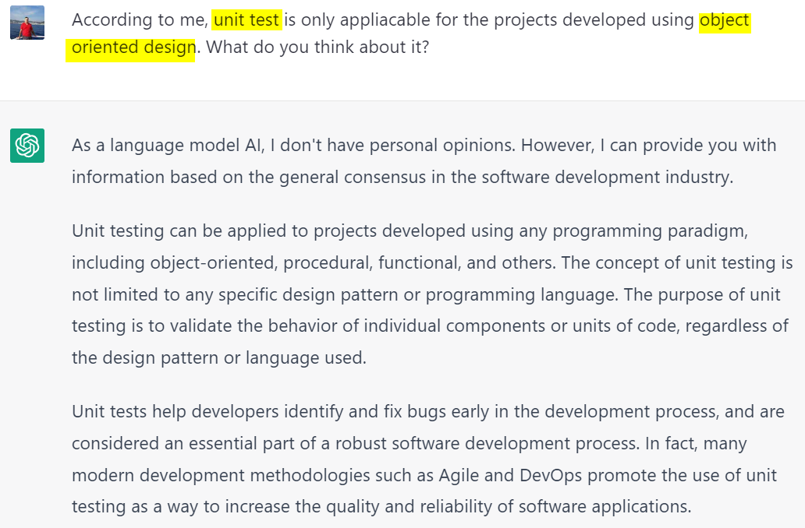

Slide 10
Potentials for Learners and Educators Personalized Feedback and Guidance
CTG can provide personalized feedback and guidance to students as they work on assignments/projects.
This can save educator’s time by automating the process of providing feedback and guidance to students.
For example: an instructor or mentor could input a student's answer, along with any specific feedback or guidance they would like to provide, and ChatGPT could generate personalized feedback based on this information

Slide 11
Potentials for Learners and Educators Personalized Feedback and Guidance
For students, personalized feedback help students better understand their strengths and weaknesses and can provide them with targeted support and guidance to improve their performance and learning outcomes.

Slide 12
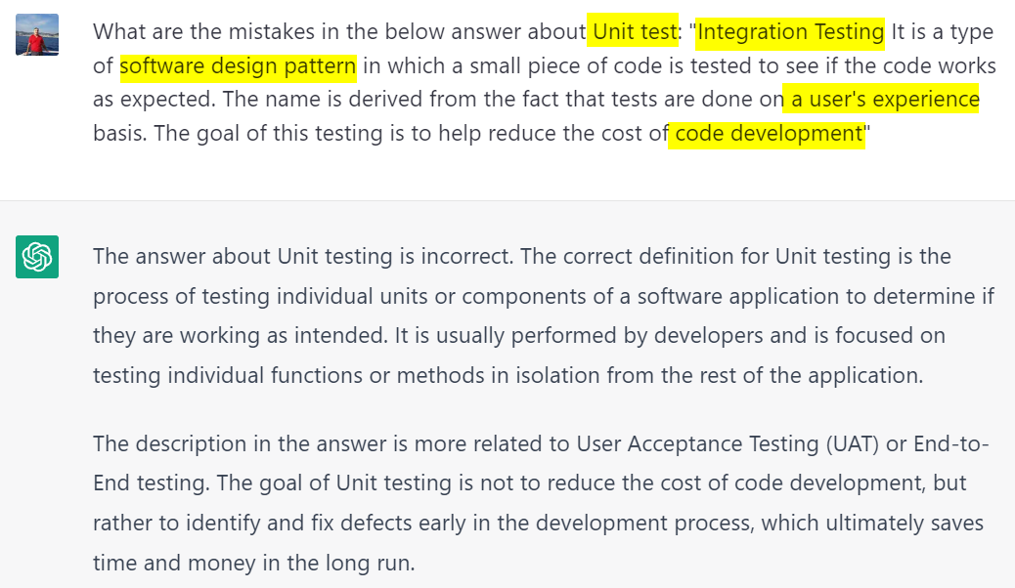
Potentials for Learners and Educators Personalized Feedback and Guidance

Slide 13
Potentials for Learners and Educators Automatic Code Generation and Testing
One of the main advantages of using CGT to generate code is that it can save students a significant amount of time.
Students can focus on higher-level tasks, such as designing algorithms or testing code, rather than spending time on the tedious process of writing code.
By examining the generated code, students can learn about coding conventions and best practices, and they can use this knowledge to improve their coding skills.

Slide 14
Potentials for Learners and Educators Automatic Code Generation and Testing
CTG can also be used to improve or correct the student’s code automatically based on certain constraints or requirements, allowing students to practice their coding skills and receive immediate feedback on their work.
Thereby students can improve their coding skills more quickly and effectively

Slide 15
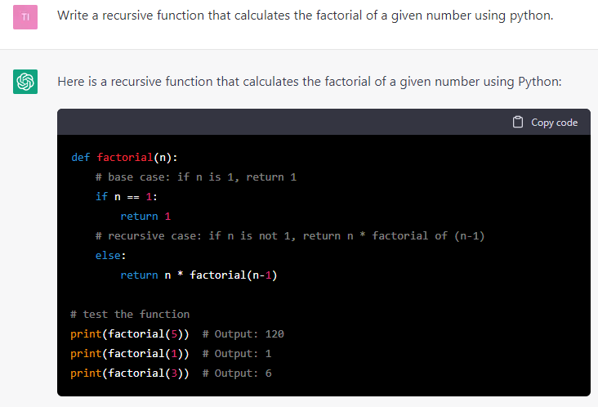
Potentials for Learners and Educators Automatic Code Generation and Testing
CTG can also be used to improve or correct the student’s code automatically based on certain constraints or requirements, allowing students to practice their coding skills and receive immediate feedback on their work.
Thereby students can improve their coding skills more quickly and effectively

Slide 16
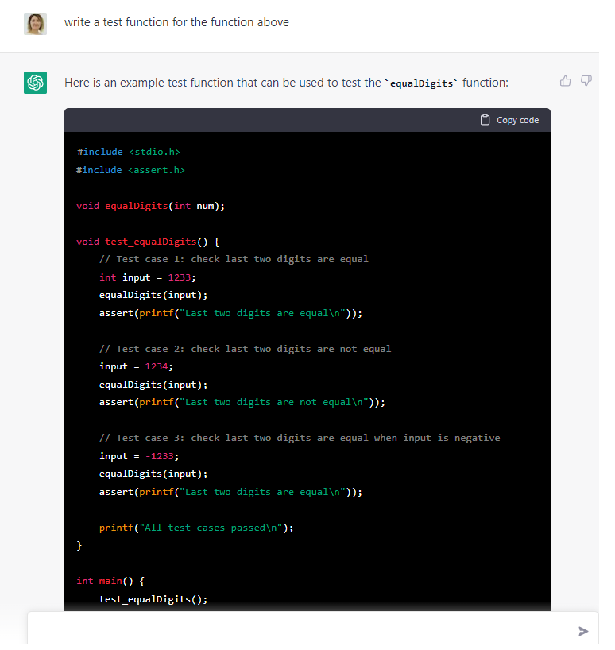

Slide 17
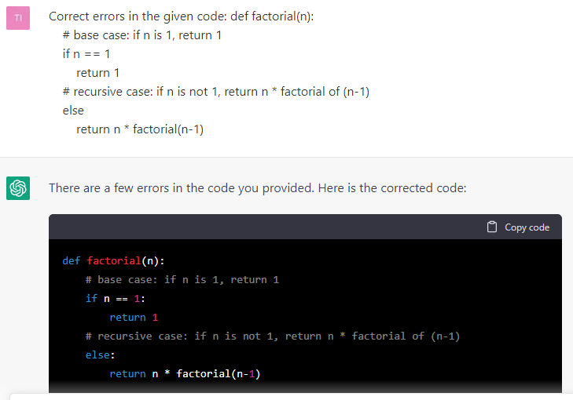
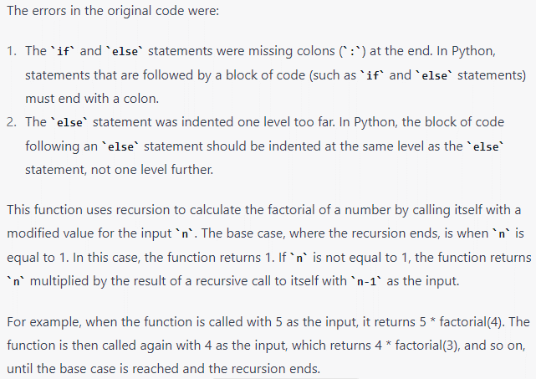

Slide 18
Potentials for Learners and Educators Collaborative Learning
CTG can facilitate the sharing of ideas and the generation of code, creating a more interactive and engaging learning experience.
CTG can help students improve their communication skills by generating clear and accurate documentation and reports, which can be especially useful for students who are not native English speakers.
This can be especially important in collaborative learning environments.

Slide 19
Potentials for Learners and Educators Generating code documentation
Code comments, commit messages, and release notes can improve a developer's understanding of a program by providing clear and thorough documentation [12, 13].
CTG can also generate high-quality documentation for code, which can be an important resource for developers and help students better understand the purpose and functionality of the code, as well as facilitate collaboration within a team.

Slide 20
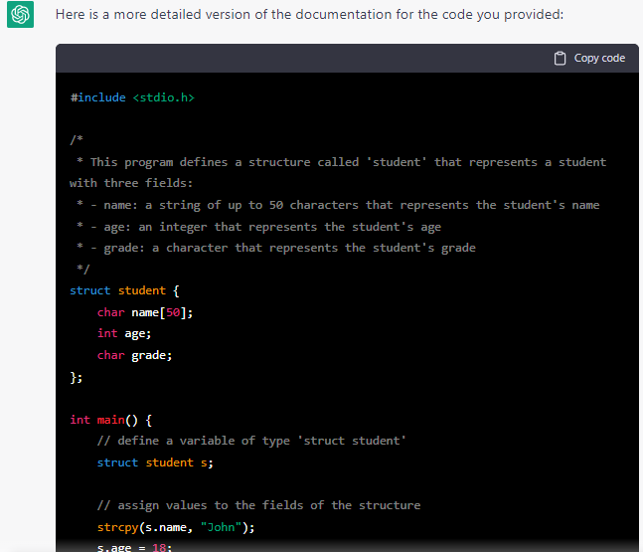
Potentials for Learners and Educators Generating code documentation
CTG can save time for educators and mentors by automating the process of creating code documentation as well.

Slide 21
Potentials for Learners and Educators Generating code documentation
Thus, CTG can save time for educators and mentors by automating the process of creating code documentation as well.

Slide 22
Potentials for Learners and Educators Summary
However, it is important to note that while CTG can be a useful tool for improving the efficiency and effectiveness of software engineering education, for the time being, it is not a replacement for human instruction and guidance.

Slide 23
Risks for Learners and Educators

Slide 24
Risks for Learners and Educators Plagiarism
ChatGPT, as any other CTG, may generate “original” text using the train dataset, but it is important to recognize that this text is not the work of the student or educator using the tool.
Thus, using the output can be considered plagiarism.
Therefore, in education, we need new tools, measurement and evaluation methods to detect and react this kind of plagiarism.

Slide 25
Risks for Learners and Educators Dependence
As we see above, CTG can assist with debugging, testing, troubleshooting and to provide guidance and suggestions for code improvements.
Educators and learners should be mindful of their reliance on ChatGPT and ensure that they are using it as a supplement to, rather than a replacement for, traditional teaching and learning methods.
Relying too heavily on ChatGPT or similar models could lead to a lack of critical thinking and originality.

Slide 26
Risks for Learners and Educators Misinformation
ChatGPT, as any other CTG, is trained on a large dataset of text from the internet, and this dataset may contain misinformation or biased information.
As a result, ChatGPT may provide incorrect or misleading answers to questions.
It is important for educators and learners to fact-check any information provided by ChatGPT and to critically evaluate its sources.

Slide 27
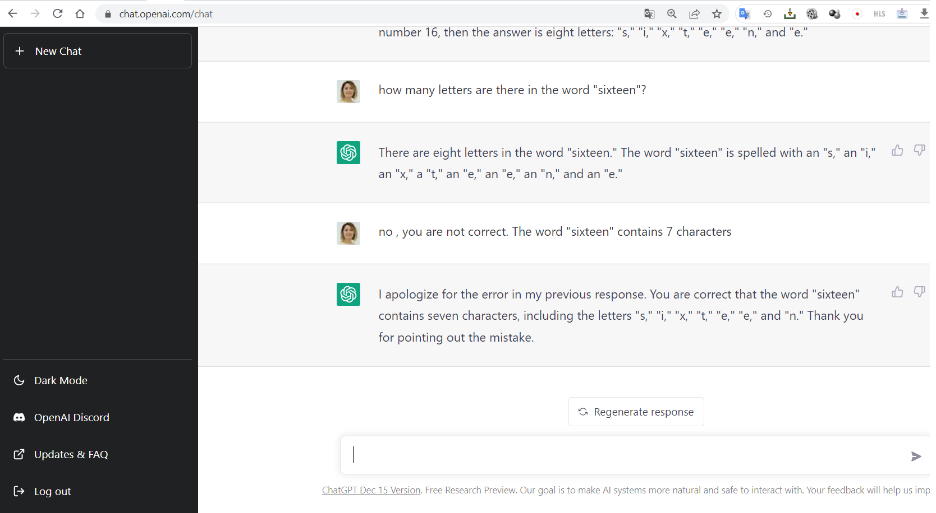
Risks for Learners and Educators Misinformation

Slide 28
Risks for Learners and Educators Distraction
ChatGPT can be a fun and engaging tool for learners, but it can also be a distraction if not used appropriately.
The distraction effect of technology on students' concentration refers to the ability of technology, particularly digital devices and tools, to divert students' attention away from their studies and other educational activities.

Slide 29
Risks for Learners and Educators Ethical Considerations
ChatGPT, as any other CTG, has been trained on a dataset of text collected mostly from the internet, which may include biased, sensitive, personal, or copyrighted information.
Thus, it is important to consider the ethical implications of using such a tool in education.

Slide 30
Discussion and Conclusions

Slide 31
Discussion and Conclusions
Using a powerful CTG model can provide new opportunities in Software Engineering education as well as introduce new challenges.
First, we believe that as educators we should be aware of these kinds of tools available for students and educators.
We need to incorporate these kinds of tools into education materials and get prepared to use them and help students to benefit from them.

Slide 32
Discussion and Conclusions
After admitting their existence, we need to review the education process including measurement and evaluation techniques.
For example, grading homework and projects might not be a fair or wise option if an answer can be generated from this kind of tool.
Therefore, we believe that we should not grade homework and projects if they are out-of-class activities.
We can allocate time during classes or labs for homework and projects under the instructor’s monitor ensuring they are not using the CTG tools.

Slide 33
Discussion and Conclusions
As educators, we need to use special tools or methods to prevent or detect plagiarism originating form the CTG tools.
We can encourage learners to use tools like ChatGPT to test their knowledge or correct their answers.
It is important to carefully consider the limitations and potential ethical issues associated with using CTG in education and to ensure that it is used responsibly and transparently.

Slide 34
Discussion and Conclusions
While ChatGPT can be a useful supplement to traditional teaching methods, -for the time-being- it should not be relied upon as a replacement for human instruction and critical thinking skills.

Slide 35
Thank You!
Questions?

Slide 36
CHATGPT: IMPACT OF CONTROLLABLE TEXT GENERATION ON SOFTWARE ENGINEERING EDUCATION
Cansu Çiğdem Ekin Güzin Türkmen Murat Karakaya
Bilgisayar Mühendisliği
Atılım Üniversitesi

